Slide 1
Interest Points and Local Features
CMPUT 206
Dr Nilanjan Ray
Some Slides Borrowed from Kristen Grauman

Slide 2

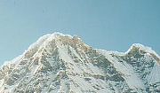
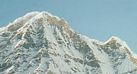
Local features: main components
Detection: Identify the interest points
Description: Extract vector feature descriptor surrounding each interest point.
Matching: Determine correspondence between descriptors in two views

Slide 3
Goal: interest operator repeatability
We want to detect (at least some of) the same points in both images.
Yet we have to be able to run the detection procedure independently per image.
No chance to find true matches!
Notes:
3

Slide 4
Goal: descriptor distinctiveness
We want to be able to reliably determine which point goes with which.
Must provide some invariance to geometric and photometric differences between the two views.
?

Slide 5
Local features: main components
Detection: Identify the interest points
Description: Extract vector feature descriptor surrounding each interest point.
Matching: Determine correspondence between descriptors in two views

Slide 6
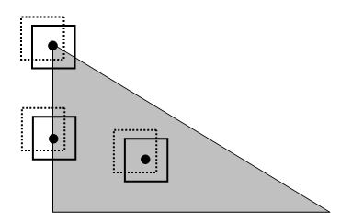
Corners as distinctive interest points
Consider a pixel and an image patch around this pixel
Imagine, you are translating this patch in a direction a tiny bit, and computing SSD (sum of squared difference) between the original patch and the translated patch
If the SSD is always large in all directions of shift, the pixel is a corner point

Slide 7
Corner detection: some math
SSD for a shift [u, v]^{T}:

Slide 8
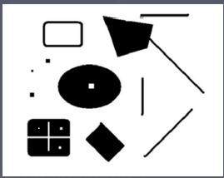
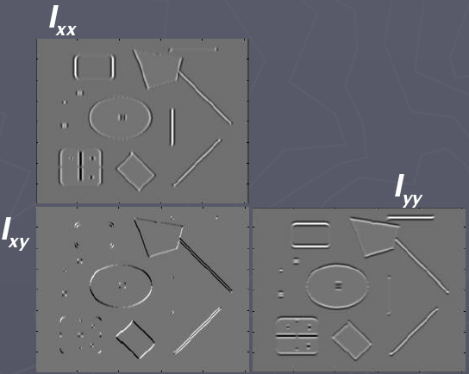
Corners as distinctive interest points
2 x 2 matrix of image derivatives (averaged in neighborhood of a point).
Notation:

Slide 9

Corners as distinctive interest points
Since M is symmetric, we have
The eigenvalues of M reveal the amount of intensity change in the two principal orthogonal gradient directions in the window.

Slide 10
Corners as distinctive interest points
“edge”:
“corner”:
“flat” region
λ₁ >> λ₂
λ₁ and λ₂ are large, λ₁ ~ λ₂;
λ₁ and λ₂ are small;
λ₂ >> λ₁
One way to score the cornerness:

Slide 11
Harris corner detector
Smooth the input image I; call smoothed image J
Compute [Ix, Iy] = gradient (J)
Form three images: Tx = Ix.^2; Ty = Iy.^2; Txy = Ix.*Iy;
Smooth these three images and call them Sx, Sy and Sxy
Form cornerness score image f = (Sx.*Sy-Sxy.^2)./(Sx+Sy)
Find points with large corner response (f > threshold)
Take the points of local maxima, i.e., perform non-maximum suppression
Notes:
11

Slide 12

Harris Detector: Steps

Slide 13

Harris Detector: Steps
Compute corner response f

Slide 14

Harris Detector: Steps
Find points with large corner response: f > threshold

Slide 15
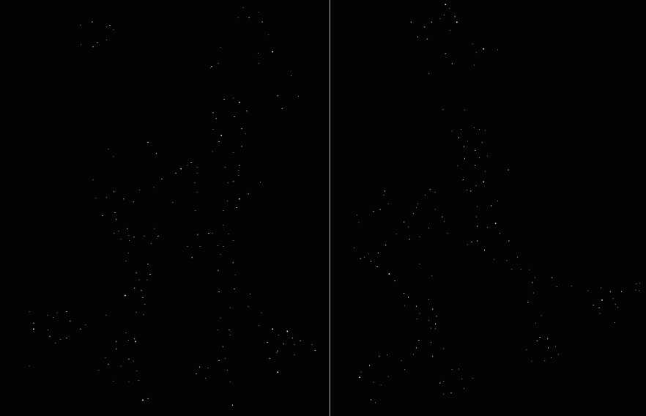
Harris Detector: Steps
Take only the points of local maxima of f

Slide 16

Harris Detector: Steps

Slide 17
Properties of the Harris corner detector
Rotation invariant?
Scale invariant?
Yes

Slide 18
Properties of the Harris corner detector
Rotation invariant?
Scale invariant?
Yes
No
All points will be classified as edges
Corner !

Slide 19
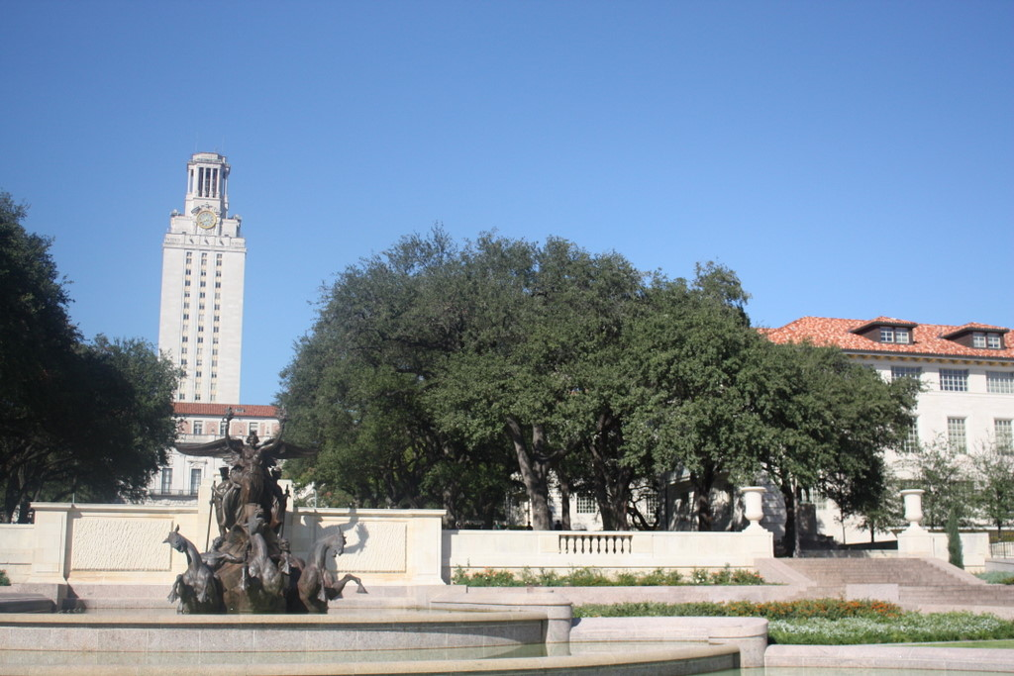
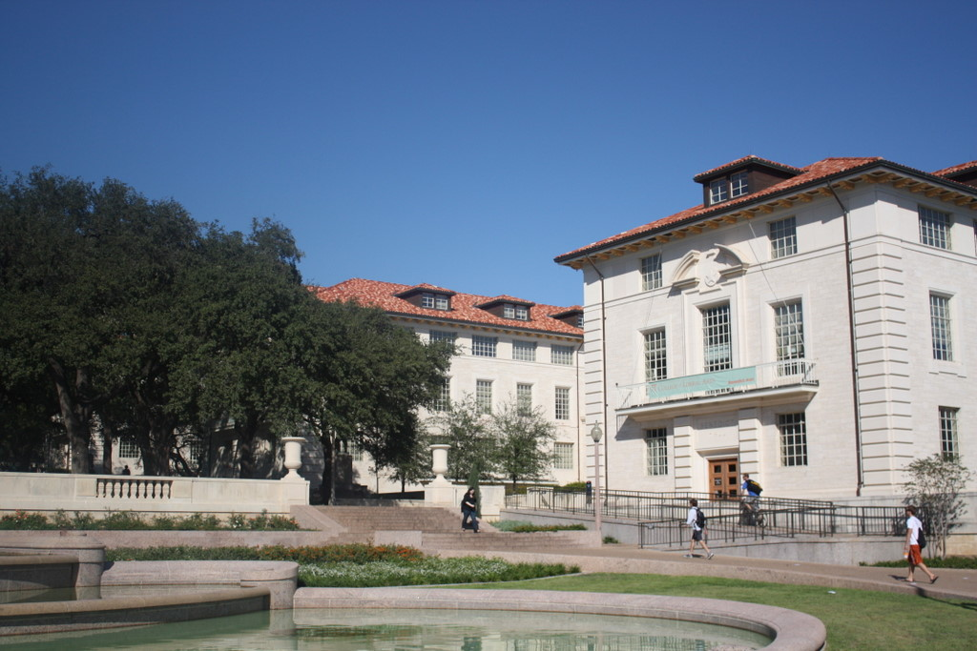
Scale invariant interest points
How can we independently select interest points in each image, such that the detections are repeatable across different scales?

Slide 20
Automatic scale selection
Intuition:
Find scale that gives local maxima of some function f in both position and scale.
f
f
Image 1
Image 2
s₁
region size
s₂
region size

Slide 21
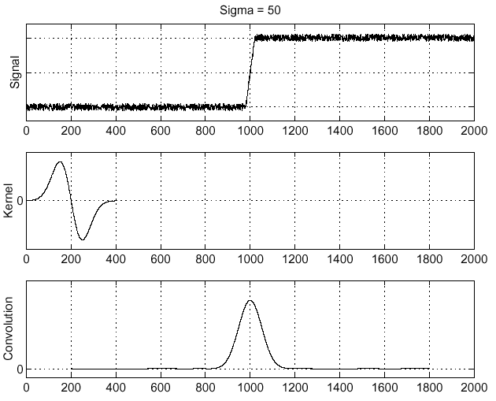
Recall: Edge detection
Edge
f
Derivative of Gaussian
Edge = maximum of derivative

Slide 22
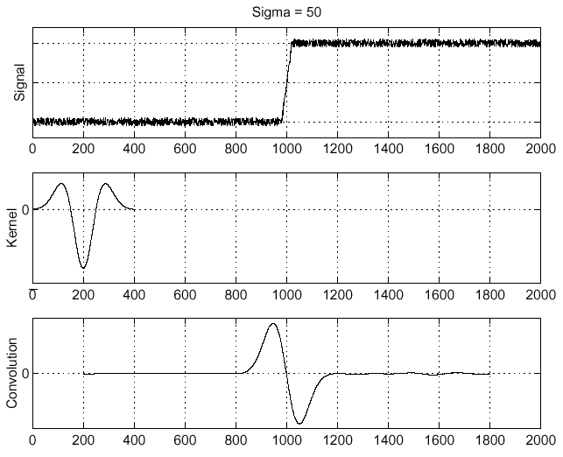
Recall: Edge detection
f
Edge
Second derivative of Gaussian (Laplacian)
Edge = zero crossing of second derivative

Slide 23
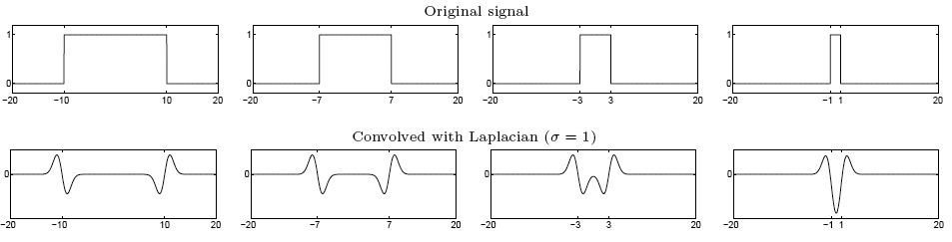
From edges to blobs
Edge = ripple
Blob = superposition of two ripples
maximum
Spatial selection: the magnitude of the Laplacian response will achieve a maximum at the center of the blob, provided the scale of the Laplacian is “matched” to the scale of the blob

Slide 24
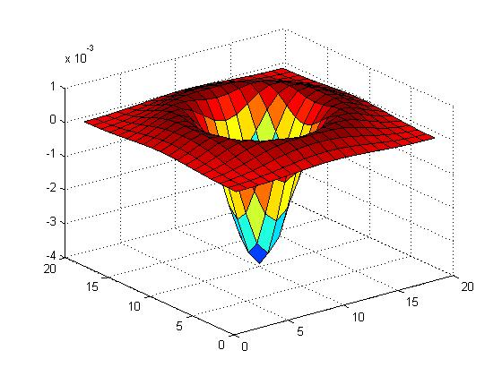

Blob detection in 2D
Laplacian of Gaussian: Circularly symmetric operator for blob detection in 2D

Slide 25
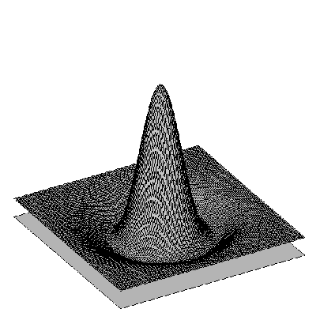

Blob detection in 2D: scale selection
Laplacian-of-Gaussian = “blob” detector
filter scales
img2
img1
img3

Slide 26
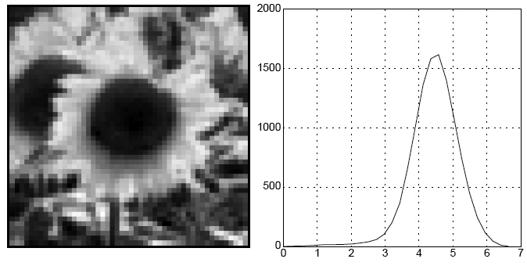
Blob detection in 2D
We define the characteristic scale as the scale that produces peak of Laplacian response
characteristic scale

Slide 27
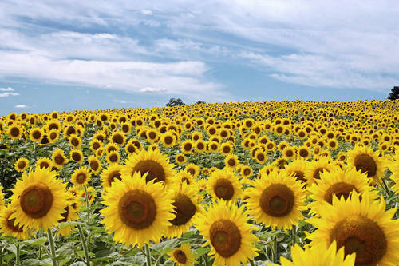
Example
Original image at ¾ the size

Slide 28
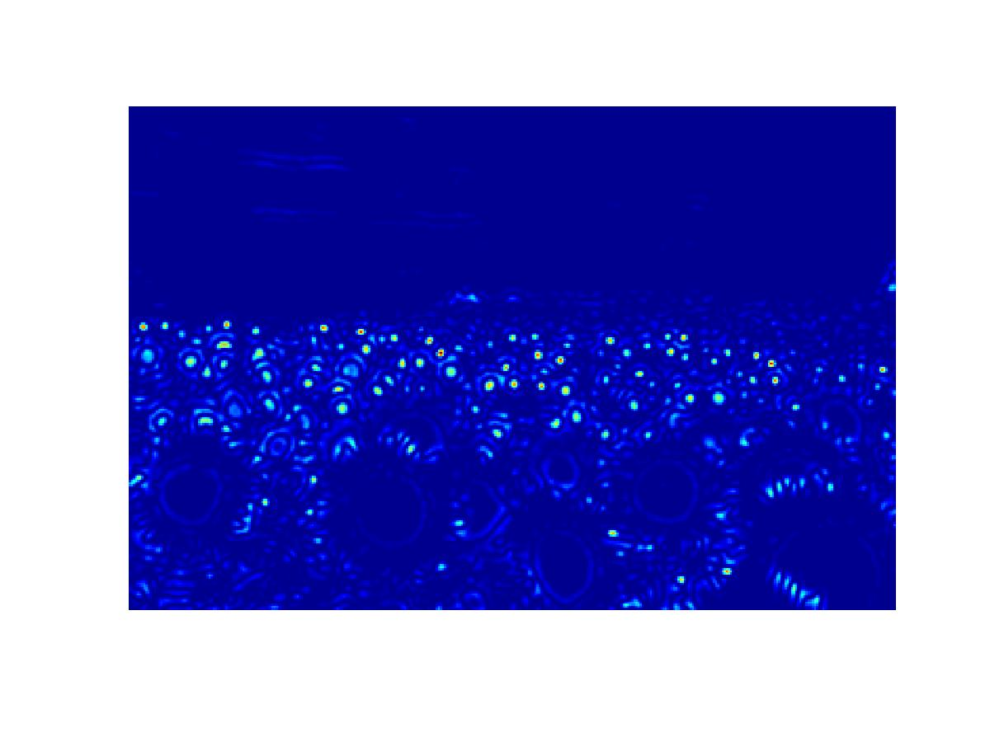
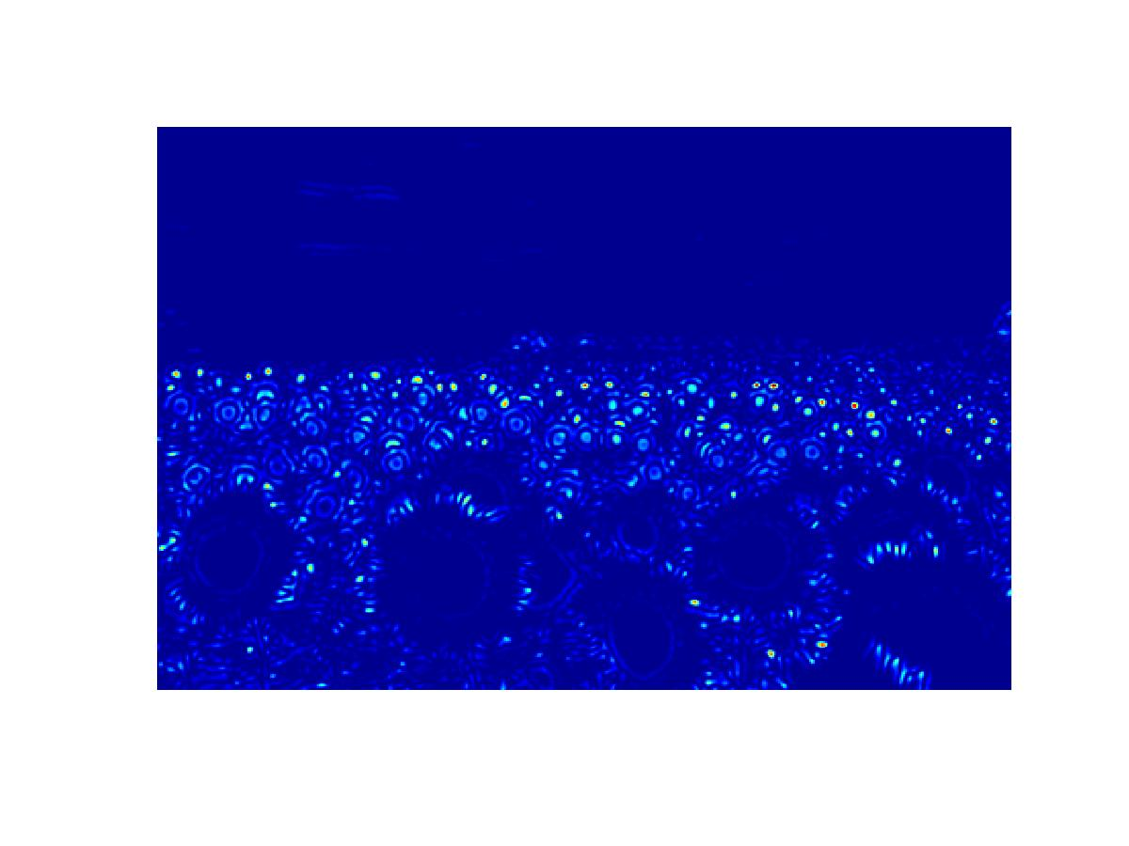
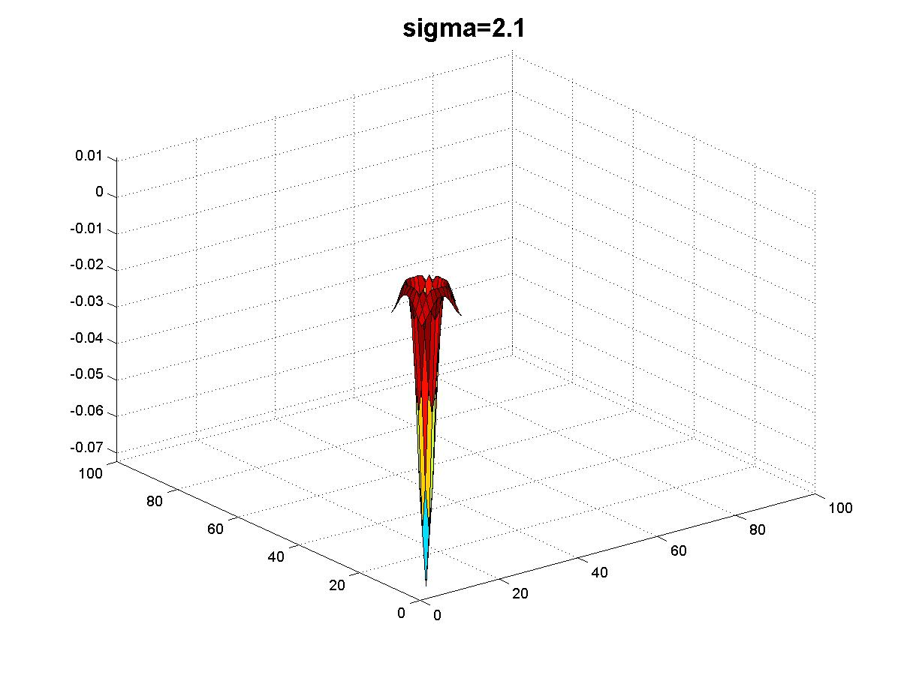
Original image at ¾ the size

Slide 29
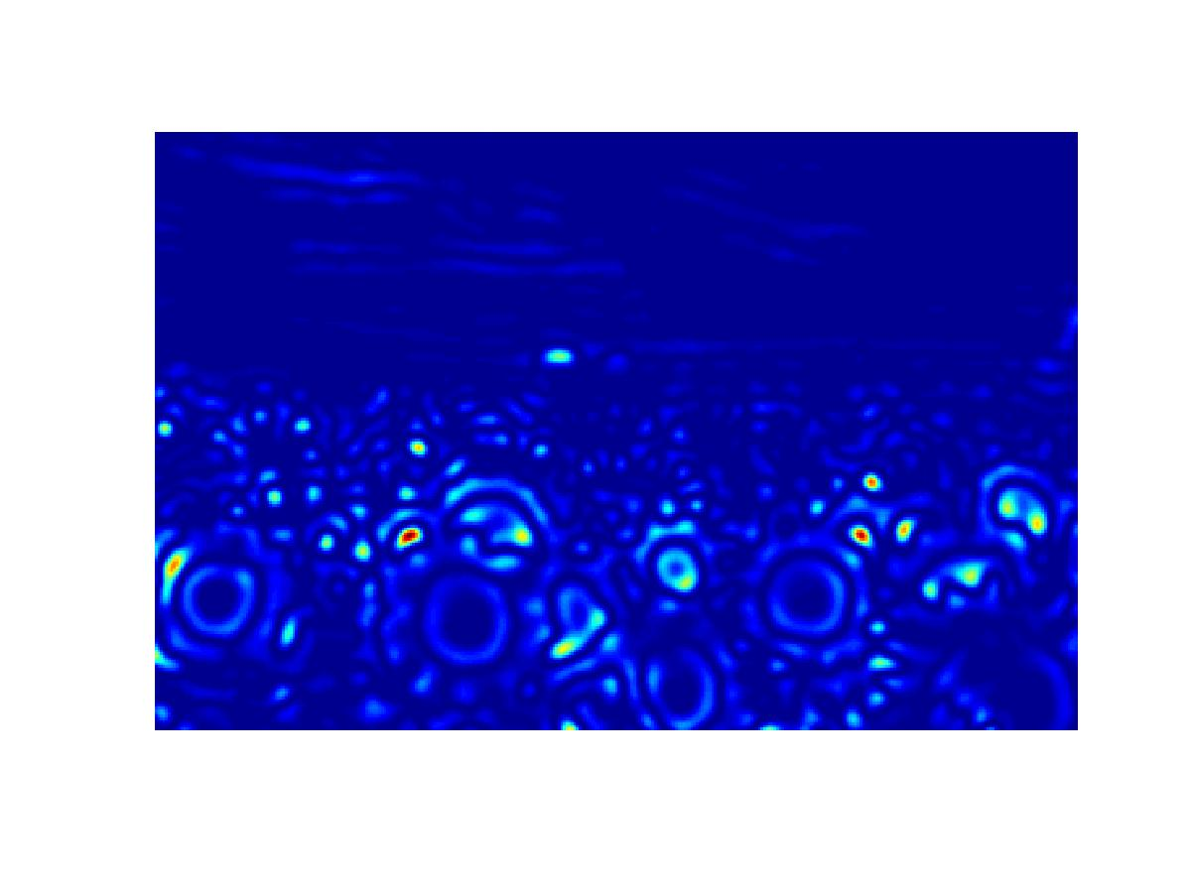
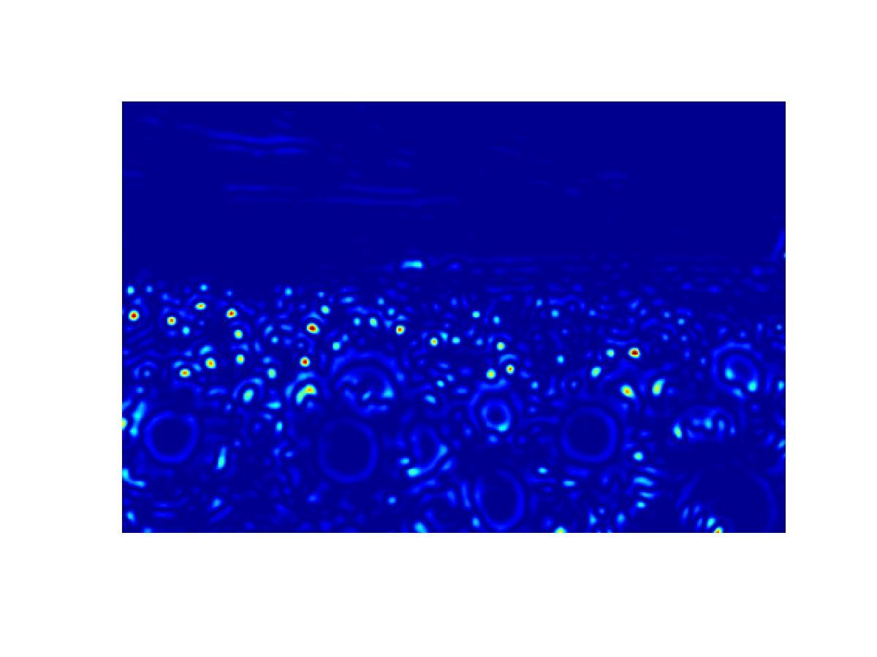
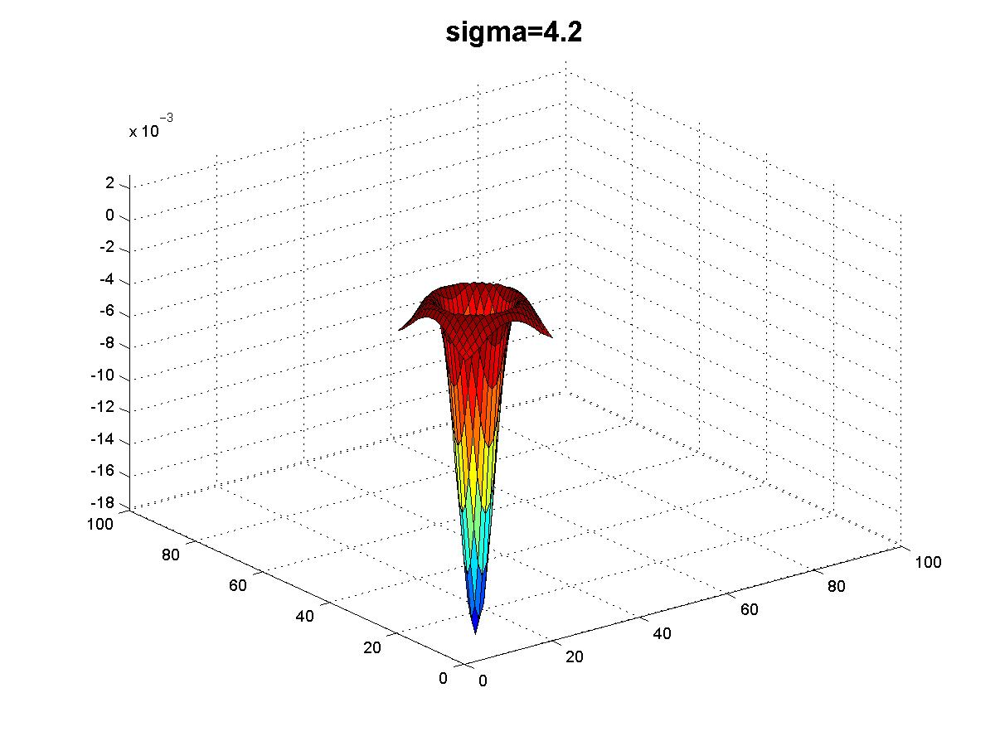

Slide 30
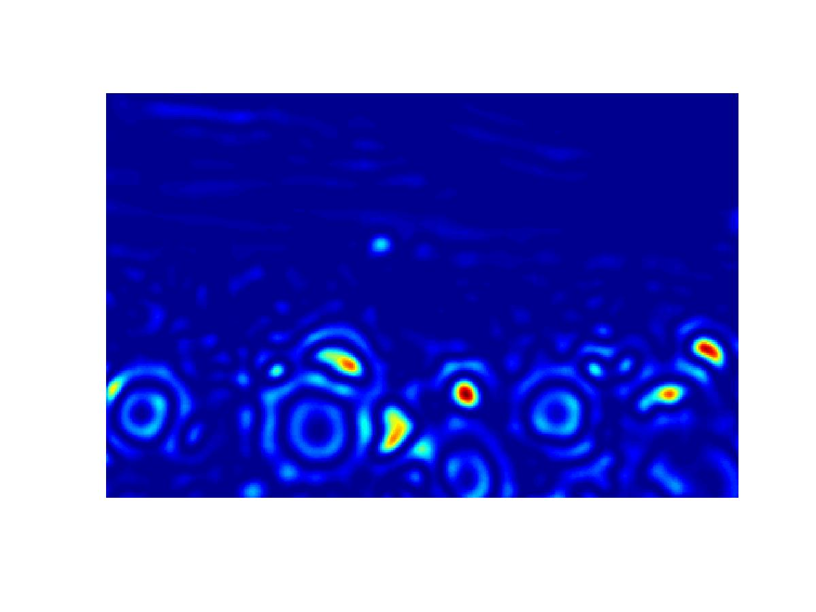
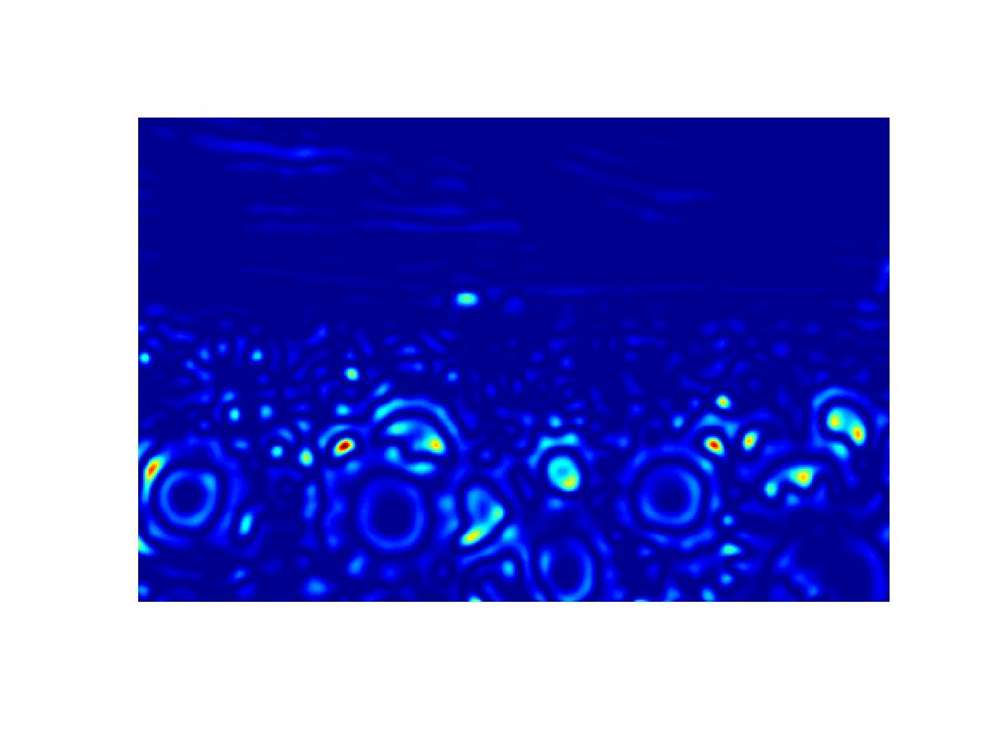
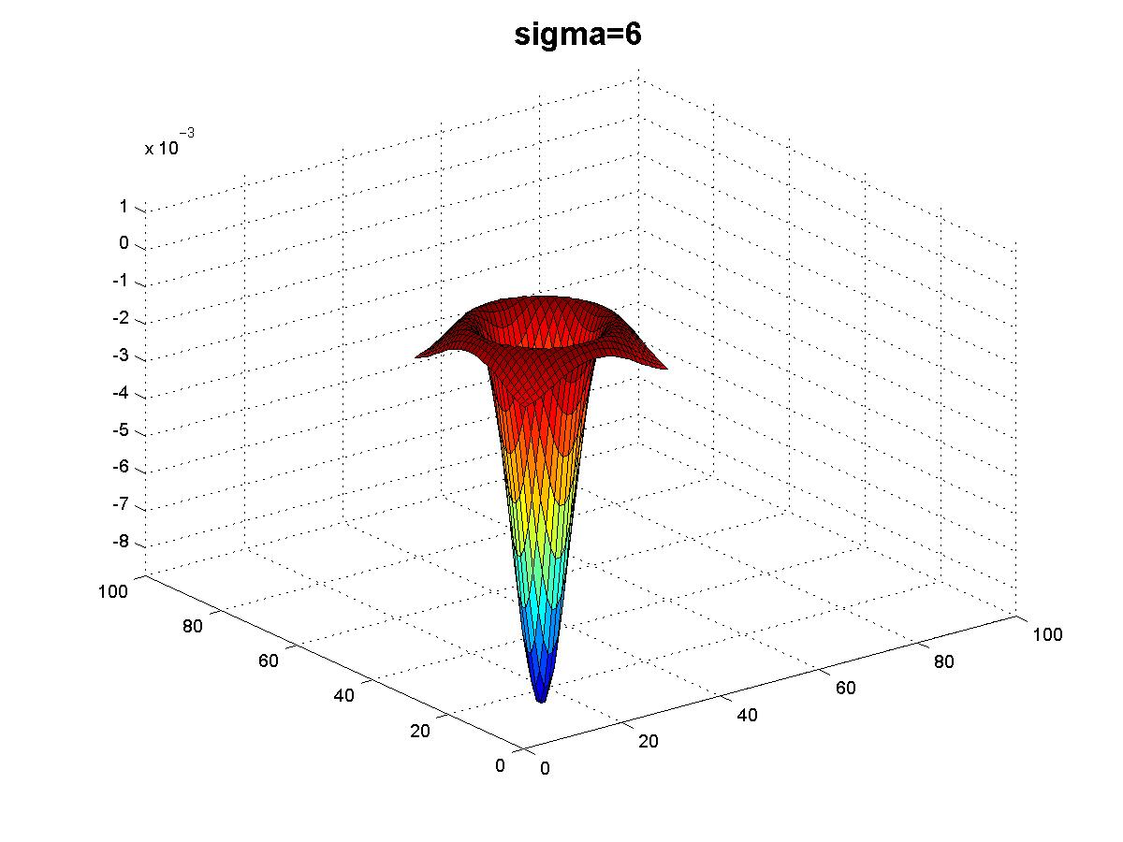

Slide 31
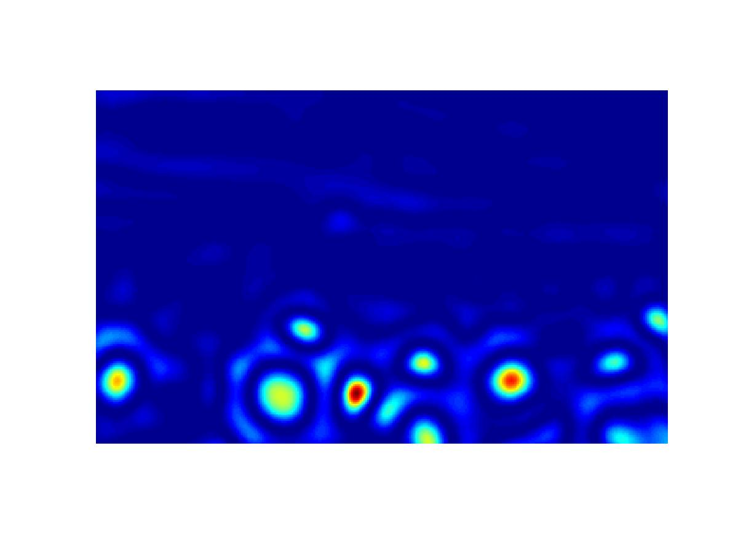
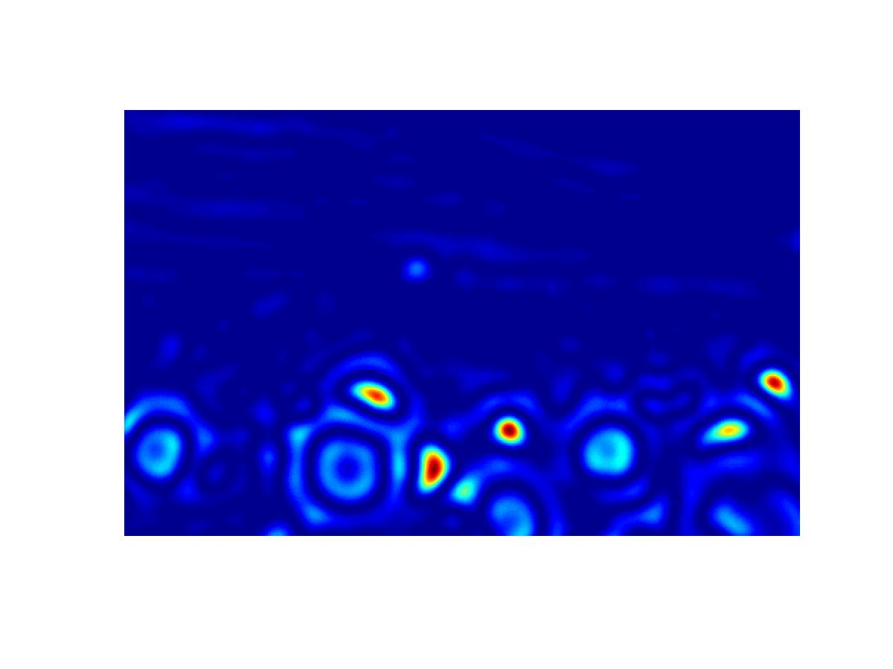
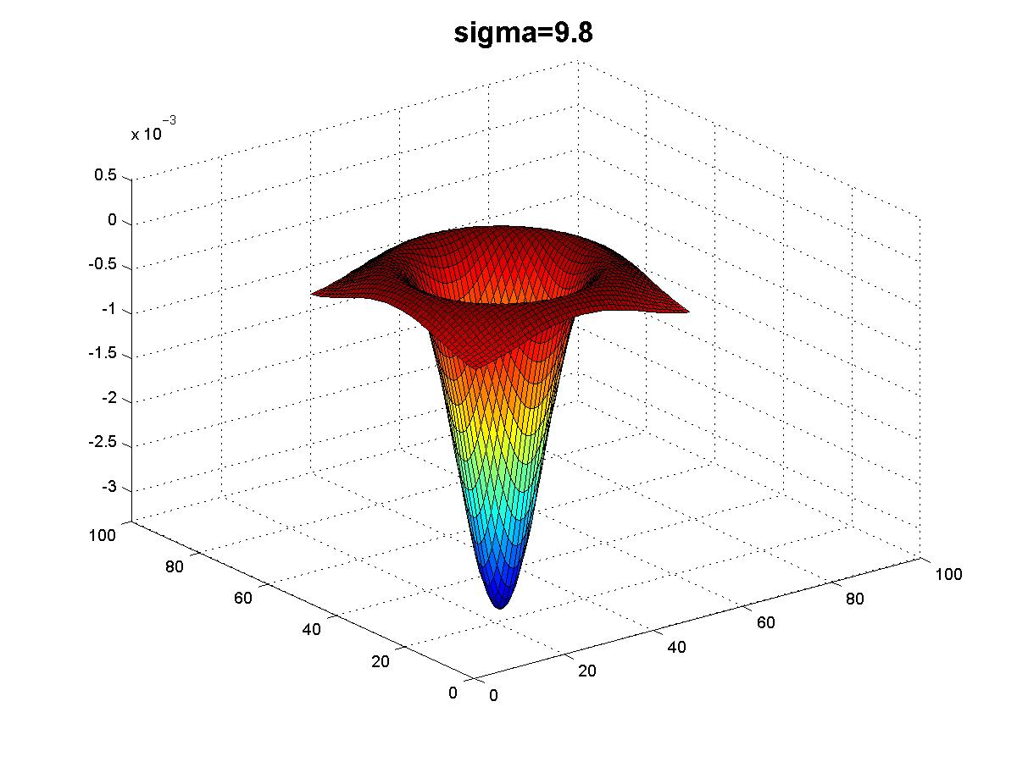

Slide 32
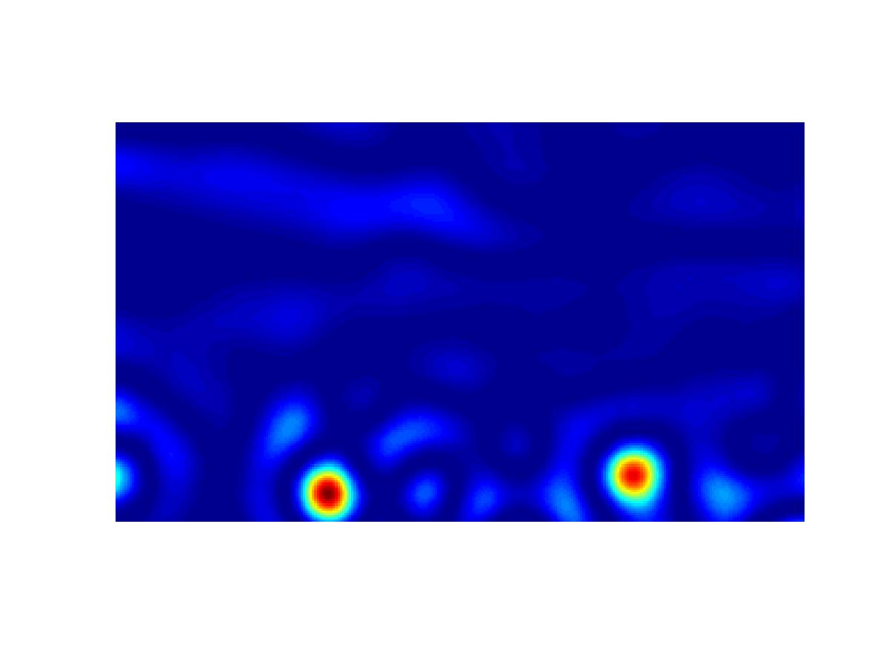
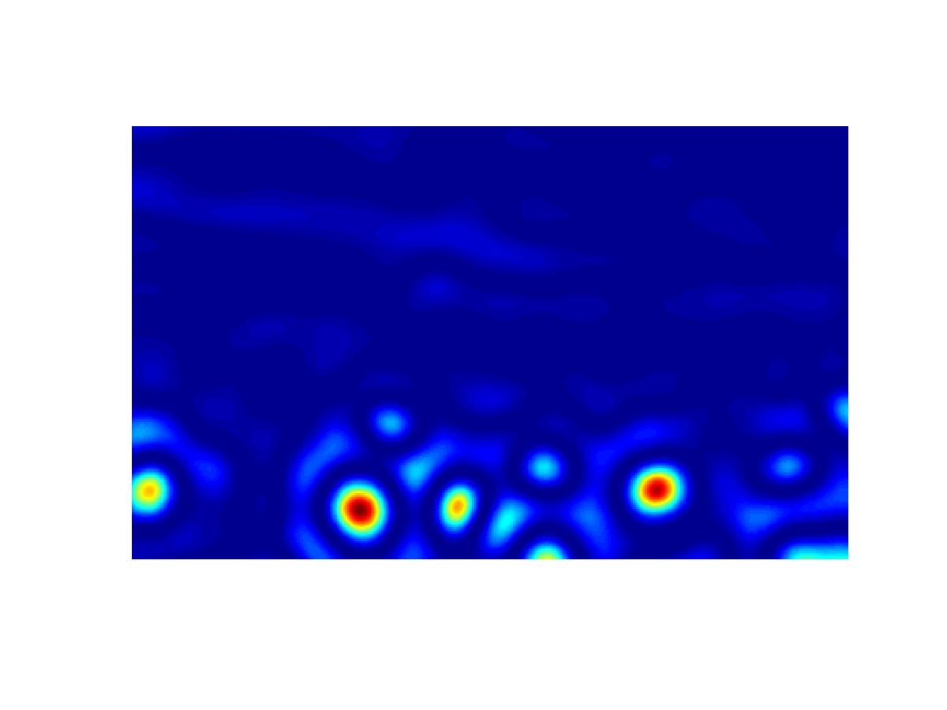
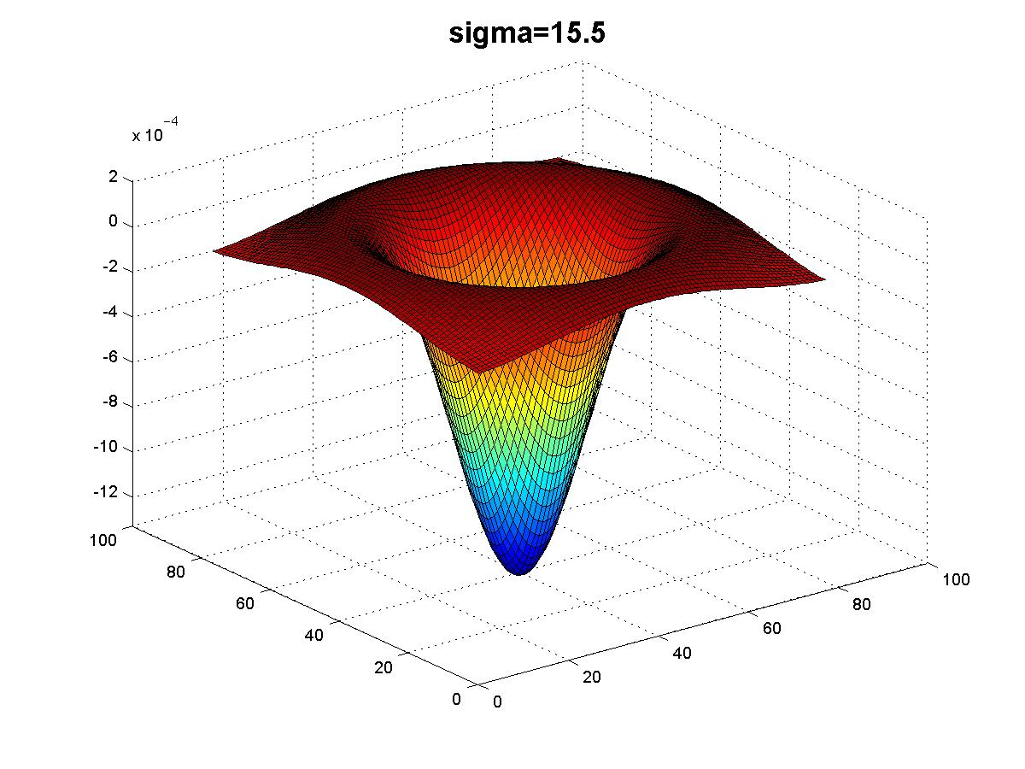

Slide 33
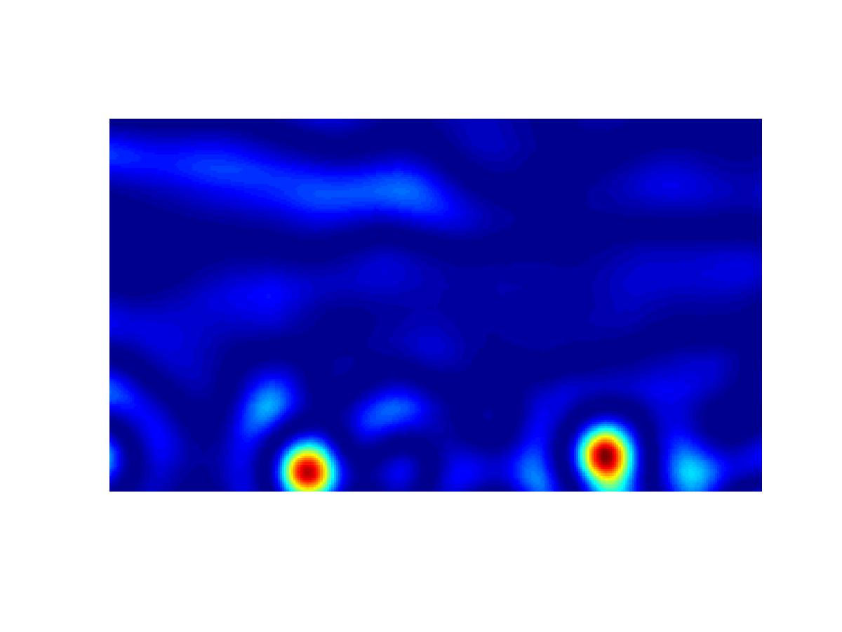
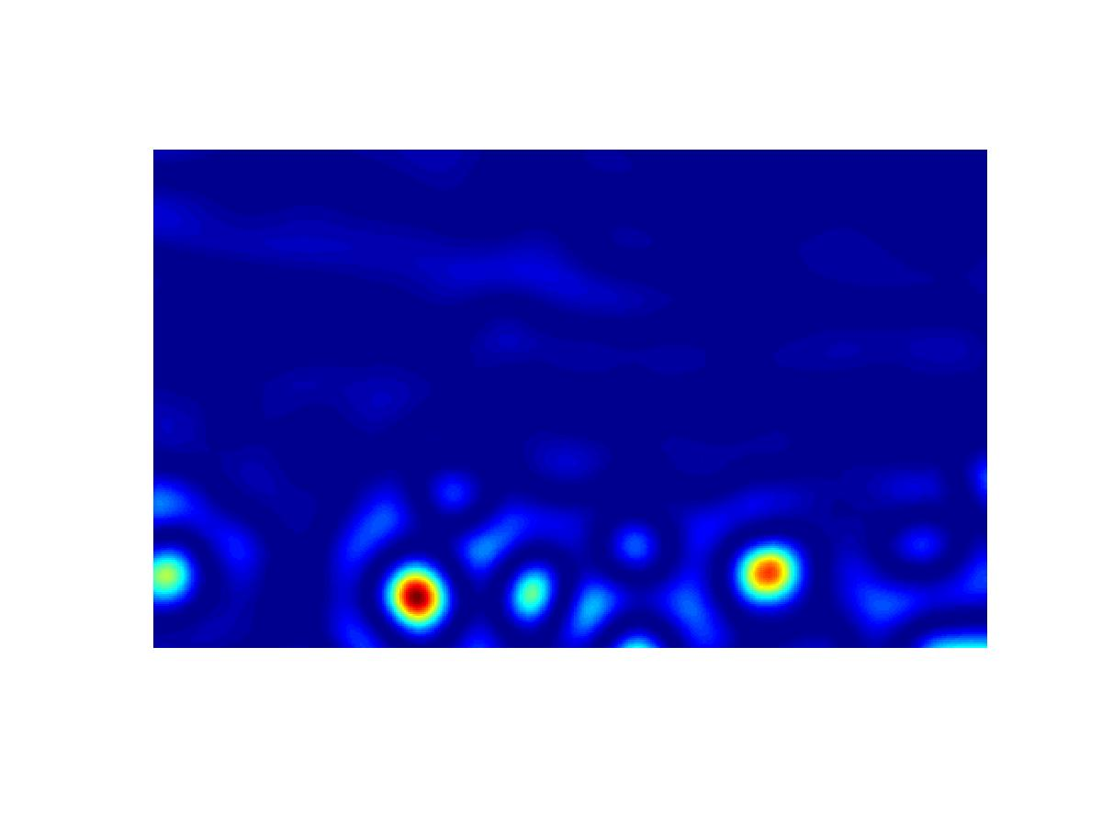
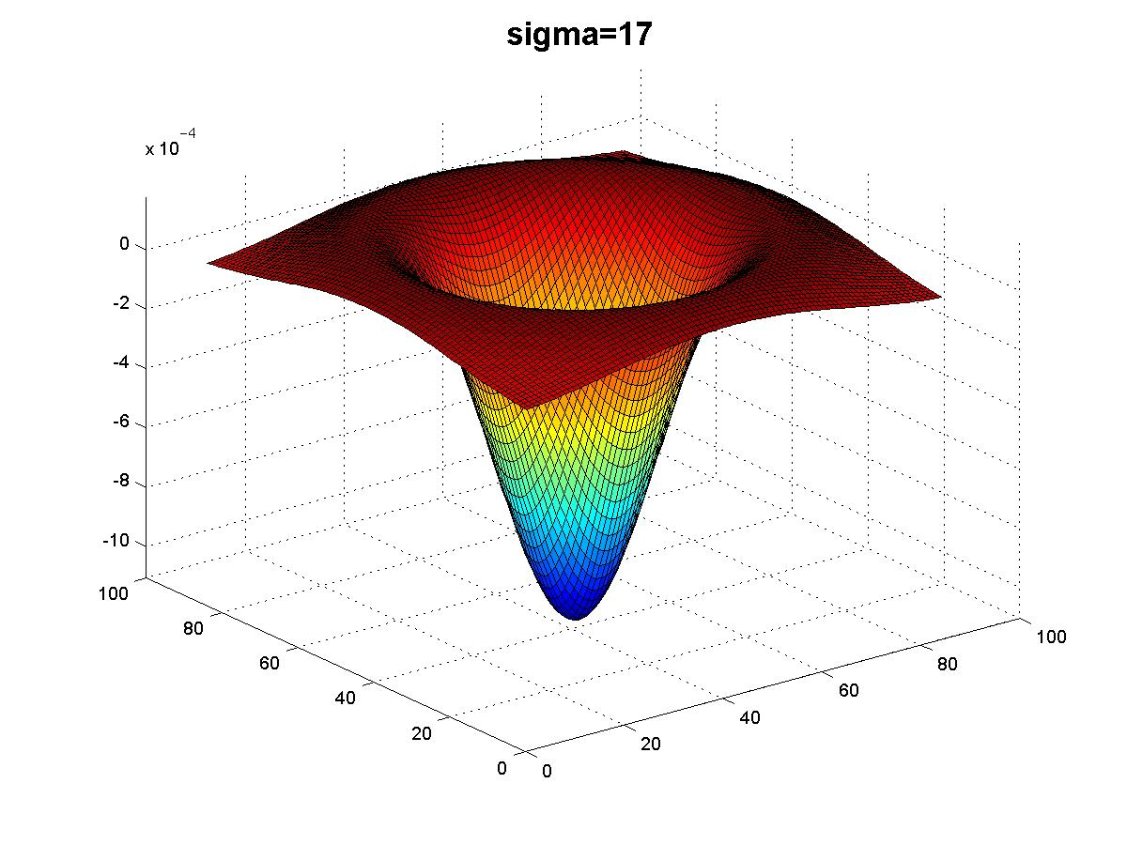

Slide 34
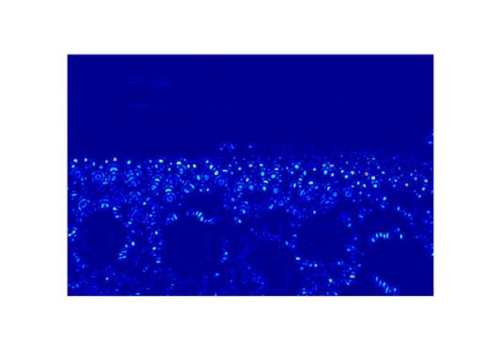
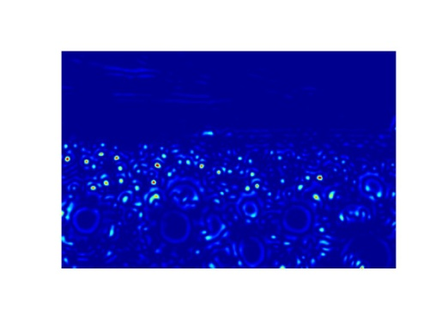
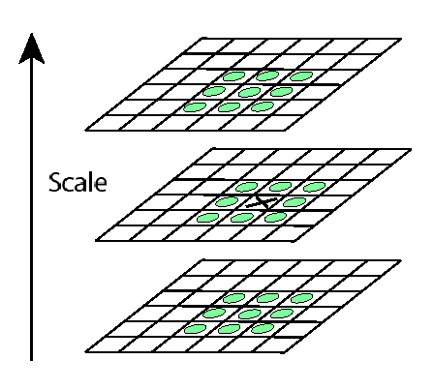
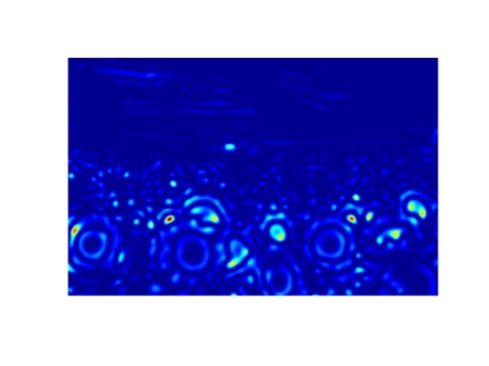
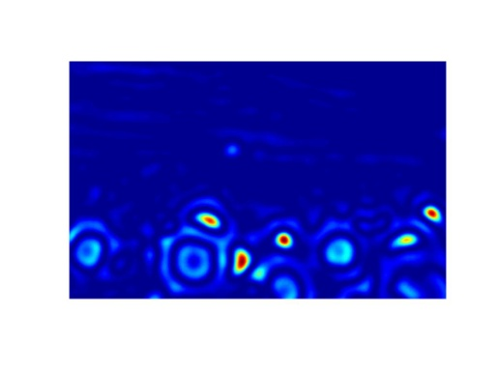

Scale invariant interest points
Interest points are local maxima in both position and scale.
σ5
σ4
scale
σ3
σ2
⇒ List of (x, y, σ)
σ1
Squared filter response maps

Slide 35
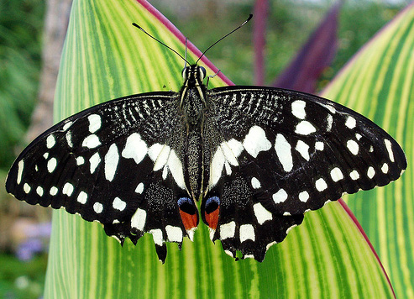
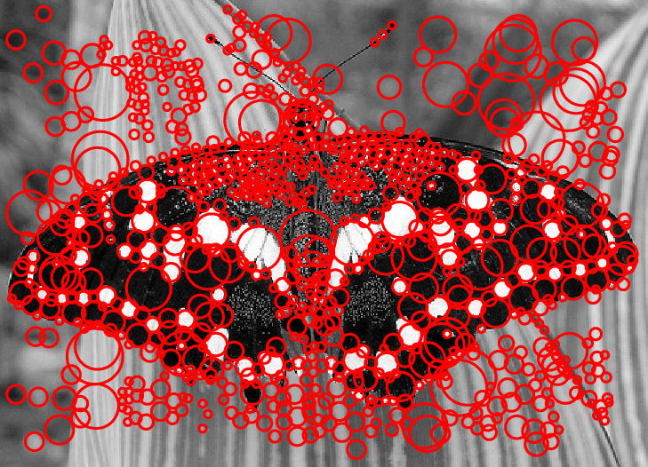
Scale-space blob detector: Example

Slide 36
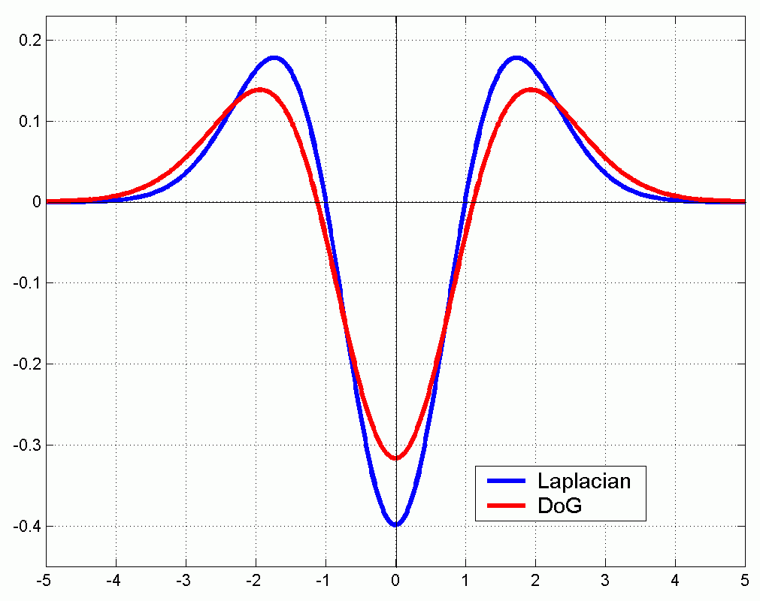
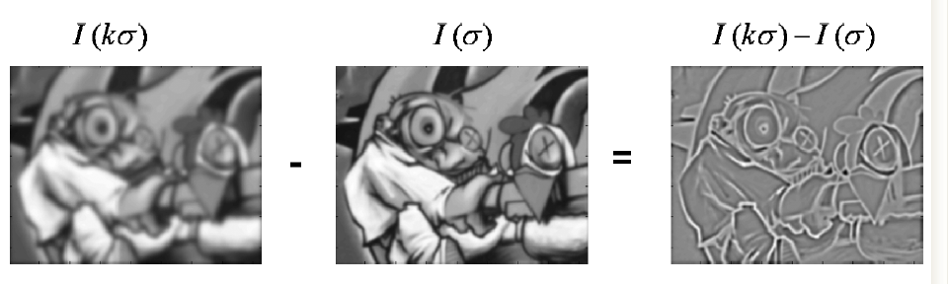
Technical detail
We can approximate the Laplacian with a difference of Gaussians; more efficient to implement.
(Laplacian)
(Difference of Gaussians)

Slide 37
Local features: main components
Detection: Identify the interest points
Description: Extract vector feature descriptor surrounding each interest point.
Matching: Determine correspondence between descriptors in two views

Slide 38

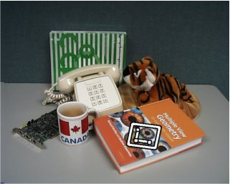


Geometric Transformations
e.g. scale, translation, rotation

Slide 39
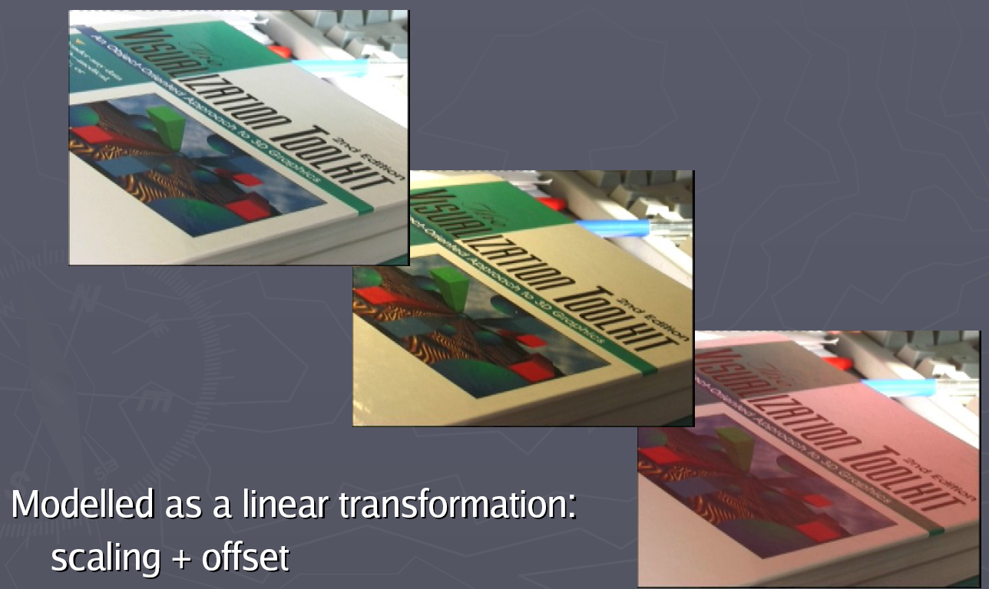
Photometric Transformations

Slide 40
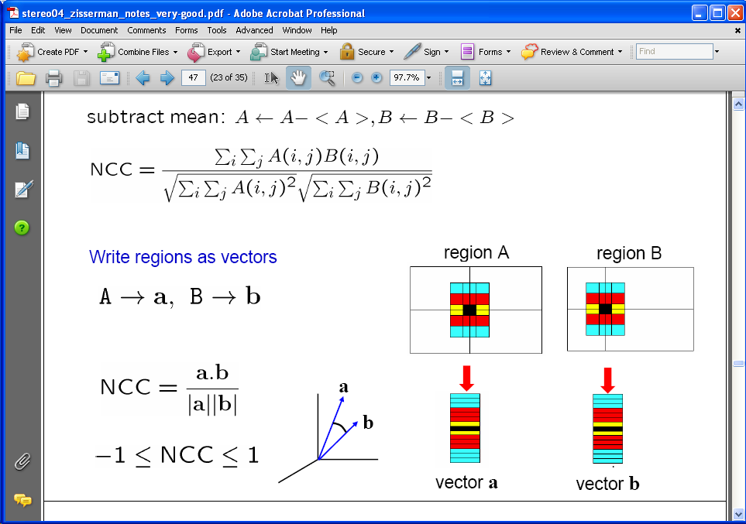
Raw patches as local descriptors
The simplest way to describe the neighborhood around an interest point is to write down the list of intensities to form a feature vector.
But this is very sensitive to even small shifts, rotations.

Slide 41

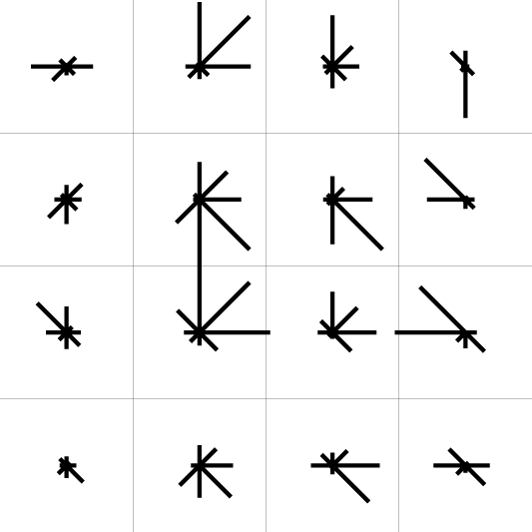
SIFT descriptor [Lowe 2004]
Use histograms to bin pixels within sub-patches according to their orientation.
0
2
π
Why subpatches?
Why does SIFT have some illumination invariance?

Slide 42
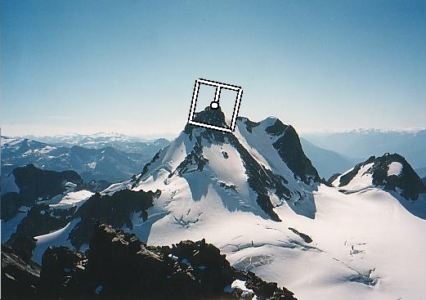
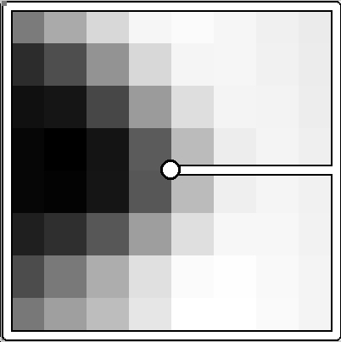
Making descriptor rotation invariant
CSE 576: Computer Vision
Rotate patch according to its dominant gradient orientation
This puts the patches into a canonical orientation.

Slide 43
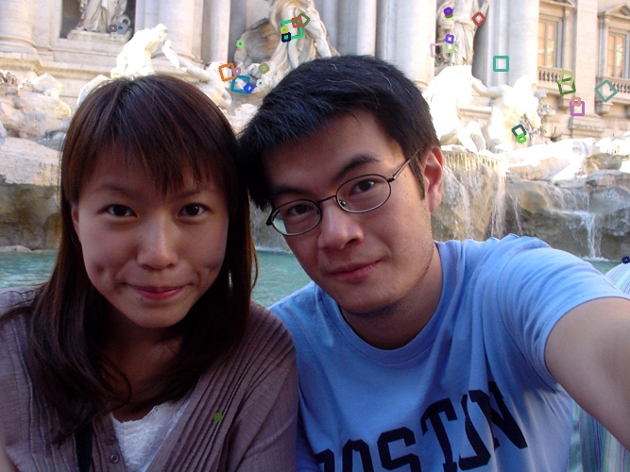
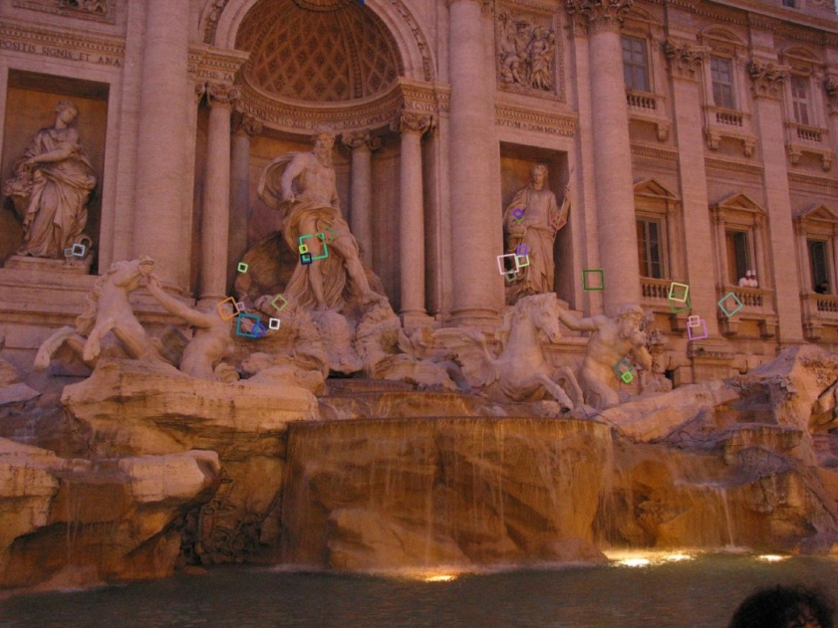
SIFT descriptor [Lowe 2004]
Extraordinarily robust matching technique
Can handle changes in viewpoint
Up to about 60 degree out of plane rotation
Can handle significant changes in illumination
Sometimes even day vs. night (below)
Fast and efficient—can run in real time
Lots of code available
http://people.csail.mit.edu/albert/ladypack/wiki/index.php/Known_implementations_of_SIFT

Slide 44


Example
NASA Mars Rover images

Slide 45


Example
NASA Mars Rover images
with SIFT feature matches Figure by Noah Snavely

Slide 46
SIFT Properties
Invariant to
Scale
Rotation
Partially invariant to
Illumination changes
Camera viewpoint
Occlusion, clutter

Slide 47
Local features: Main components
Detection: Identify the interest points
Description: Extract vector feature descriptor surrounding each interest point.
Matching: Determine correspondence between descriptors in two views

Slide 48


Matching local features

Slide 49


Matching local features
?
Image 1
Image 2
To generate candidate matches, find patches that have the most similar appearance (e.g., lowest SSD)
Simplest approach: compare them all, take the closest (or closest k, or within a thresholded distance)
Kristen Grauman

Slide 50
Ambiguous matches
?
?
?
?
Image 1
Image 2
At what SSD value do we have a good match?
To add robustness to matching, can consider ratio : distance to best match / distance to second best match
If low, first match looks good.
If high, could be ambiguous match.
Kristen Grauman

Slide 51

Matching SIFT Descriptors
Nearest neighbor (Euclidean distance)
Threshold ratio of nearest to 2nd nearest descriptor
Lowe IJCV 2004

Slide 52


Robust Feature-Based Alignment

Slide 53

Robust Feature-Based Alignment
Extract features

Slide 54
Robust Feature-Based Alignment
Extract features
Compute putative matches

Slide 55
Robust Feature-Based Alignment
Extract features
Compute putative matches
Loop:
Hypothesize transformation T (small group of putative matches that are related by T)

Slide 56
Robust Feature-Based Alignment
Extract features
Compute putative matches
Loop:
Hypothesize transformation T (small group of putative matches that are related by T)
Verify transformation (search for other matches consistent with T)

Slide 57

Robust Feature-Based Alignment
Extract features
Compute putative matches
Loop:
Hypothesize transformation T (small group of putative matches that are related by T)
Verify transformation (search for other matches consistent with T)

Slide 58
Applications of local invariant features
Wide baseline stereo
Motion tracking
Panoramas
Mobile robot navigation
3D reconstruction
Recognition

Slide 59



Automatic Mosaicing
http://www.cs.ubc.ca/~mbrown/autostitch/autostitch.html

Slide 60

Wide baseline stereo

Slide 61




Recognition of specific objects, scenes
Schmid and Mohr 1997
Sivic and Zisserman, 2003
Rothganger et al. 2003
Lowe 2002

Slide 62
Summary
Interest point detection
Harris corner detector
Laplacian of Gaussian, automatic scale selection
Invariant descriptors
Rotation according to dominant gradient direction
Histograms for robustness to small shifts and translations (SIFT descriptor)

